Slide 1

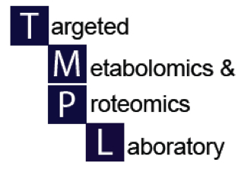

Creating files for MetaboAnalyst
UAB Metabolomics Workshop
December 2, 2015
Steve Barnes, PhD

Slide 2
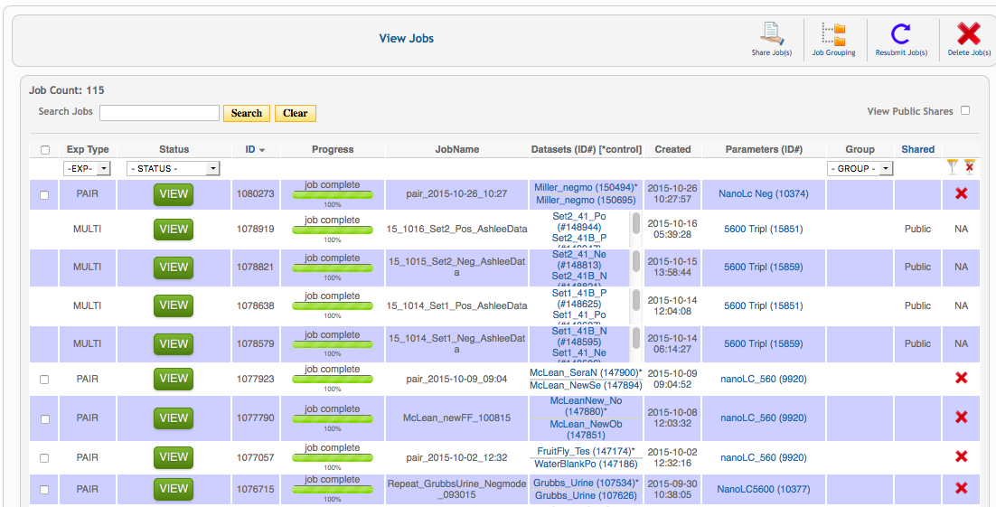
Let’s go to XCMSonline

Slide 3
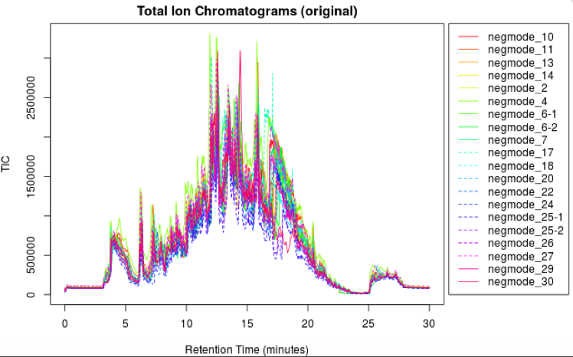
Overlay of all samples

Slide 4
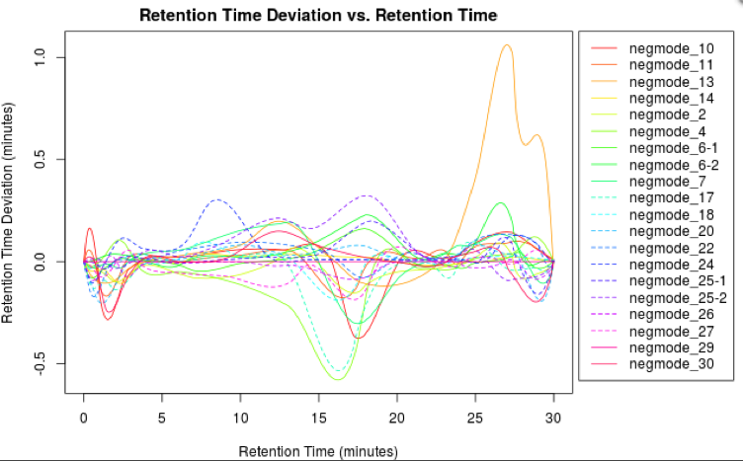
Rt variation for all samples
Eluted metabolites

Slide 5
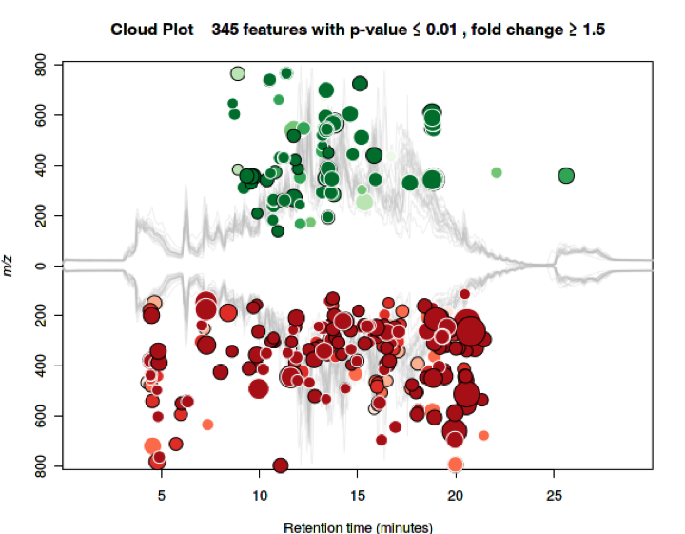

Slide 6
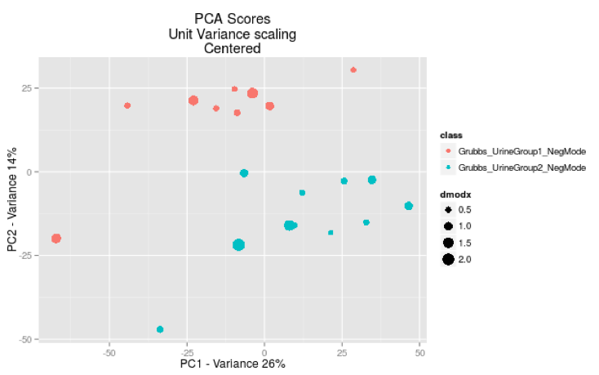
2D-PCA plot using all uncorrected data

Slide 7
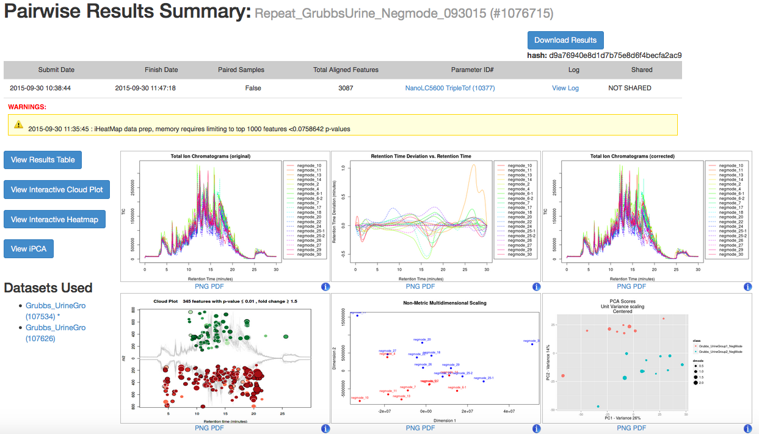
Download the processed Excel file

Slide 8
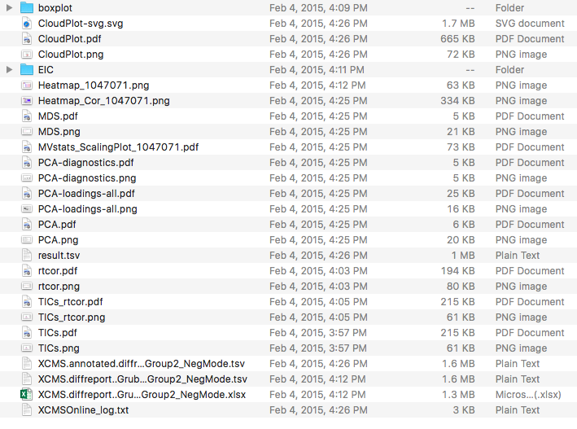
Open this Excel file

Slide 9
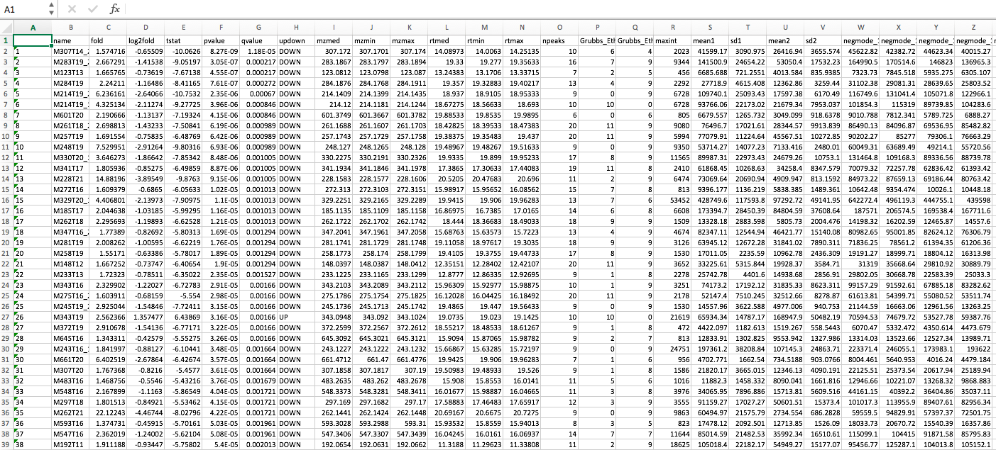
The Excel DiffReport from XCMS

Slide 10
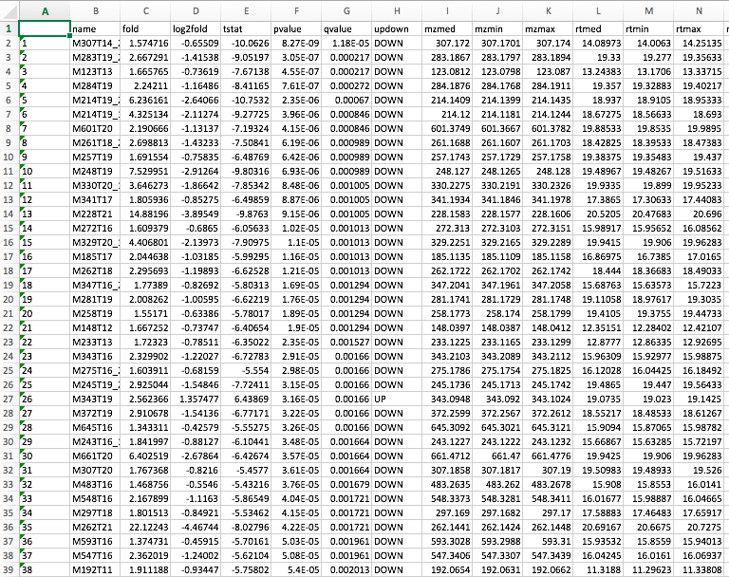

Slide 11
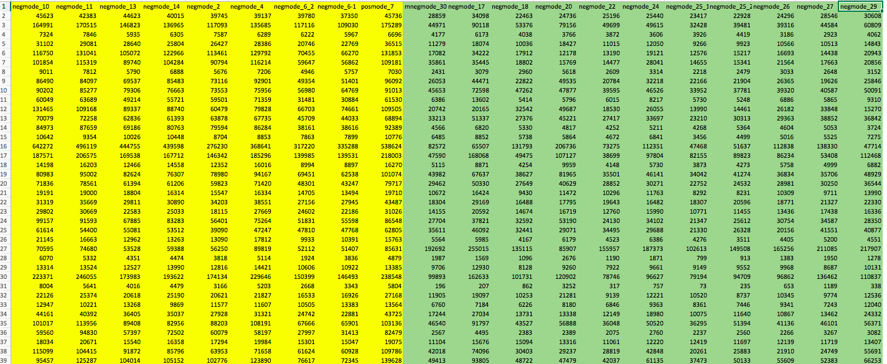
Areas of aligned metabolites by sample
Urines from animals on irradiated diet
Urines from animals on non-irradiated diet

Slide 12
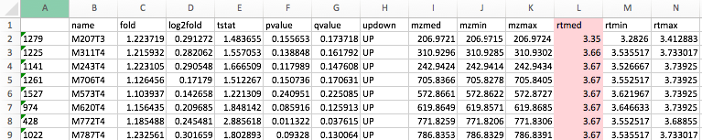
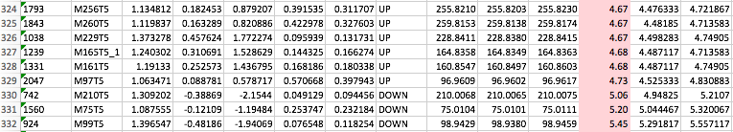
Sort the data by retention time
Scroll down to Rt 5.00 min
Keep metabolites eluting between 5.00 and 25.00 minutes

Slide 13
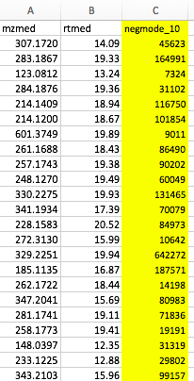
Creating .csv files for each sample
Copy the median m/z and median Rt values into a new Excel file. Then copy the column of areas from the first sample in Group_1. Save as an Excel .csv file.
  Note that the file name must not have spaces – use an underscore instead of a space.
Leave the file open and replace the yellow column with the areas from the next Group_1 sample. Save as a second .csv file.
Continue until all Group_1 and Group_2 samples have a corresponding .csv file.

Slide 14
Preparing a .zip file
Put each of the .csv files for group_1 samples into a folder named “Group_1”.
Put each of the .csv files for group_2 samples into a folder named “Group_2”.
Click on Group_1 and Group_2 folders and combine to form a .zip file.
  Rename the .zip file as [your_name].zip
You’re now ready to submit it to MetaboAnalyst

